Slide 1
Real Time UI with Apache Kafka Streaming Analytics of Fast Data and Server Push
Lucas Jellema (CTO AMIS)
@lucasjellema
http://technology.amis.nl
www.amis.nl

Slide 2
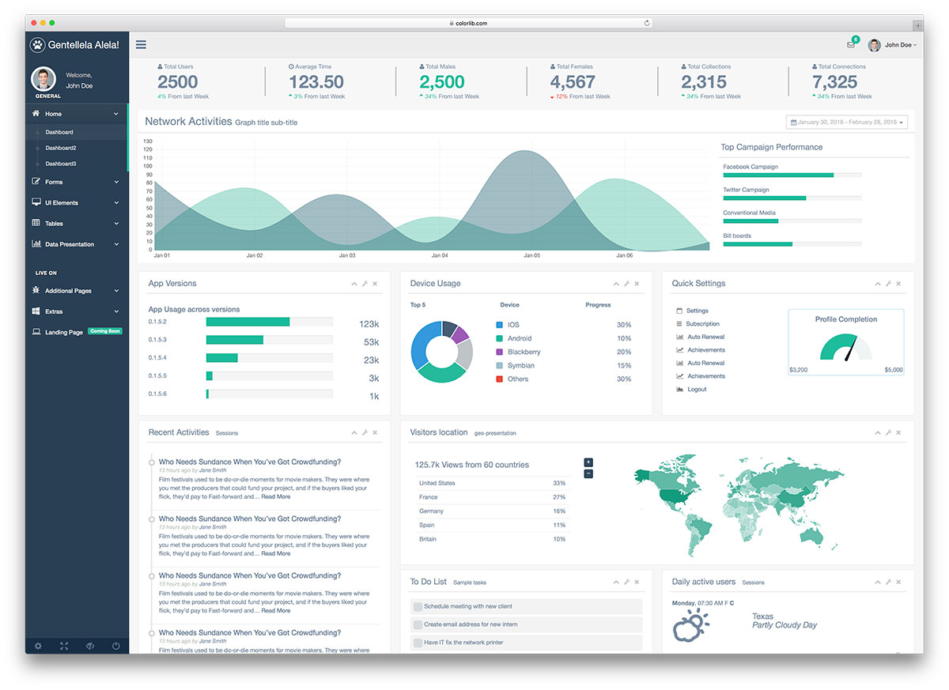

Slide 3
<F5>

Slide 4
<CTRL F5>

Slide 5
<Middleware>
F5
F5
F5
CTRLF5
CTRLF5
CTRLF5

Slide 6
<Middleware>
F5
F5
F5
CTRLF5
CTRLF5
CTRLF5

Slide 7
<Middleware>
F5
F5
F5
CTRLF5
CTRLF5
CTRLF5

Slide 8
Fast data and active UI
Handle [data | event] influx
Analyze in real time
Publish findings instantaneously
Update UI & notify end user immediately
Convince end user that the UI is (still) active (and no F5 is required)
Decoupled components
No data loss when a component is temporarily down
Scalable with volume of events and of number of clients

Slide 9

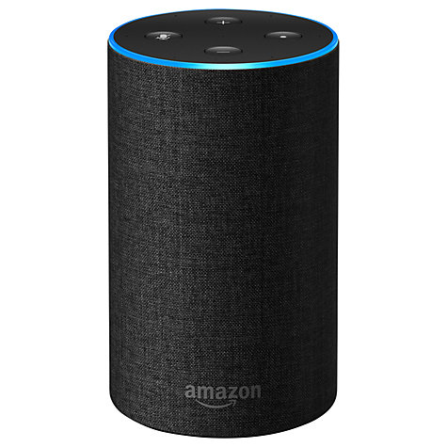
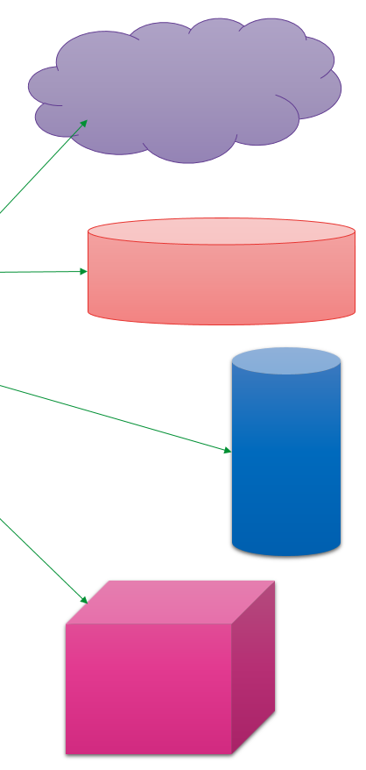
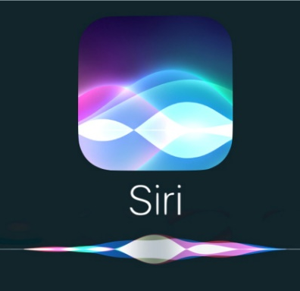

API
µ
µ
µ
µ

Slide 10


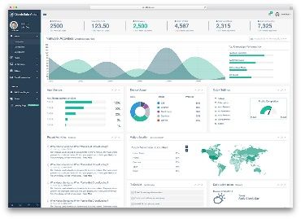


The case at hand
Standin for all Hot Sources of Live Data: IoT Physical World Reports, IT Ops, Web Click Statistics, Business Process execution, open data feeds (traffic, weather, stocks, …), Points of Sales, Social Media, microservices chatter
Tweets on #devoxxUK #java #oraclecode
Show live tweet feed for tags
Allow users to like tweets –and show live list of liked tweets
Client
Show live tweet aggregates per tag
Client
Show a live list of top 3 liked tweets per tag
Client
Client

Slide 11
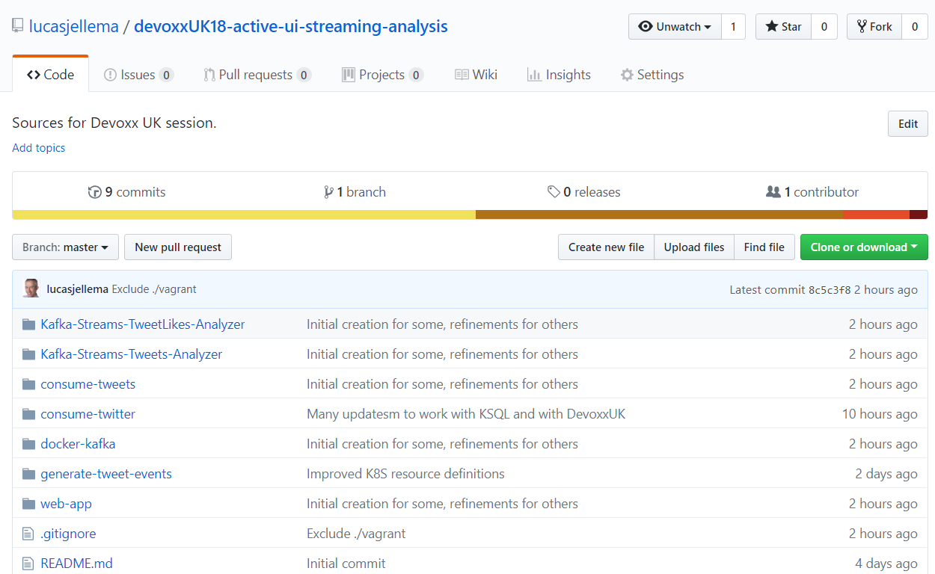
The Code
#ActiveUIDevoxxUK
https://github.com/lucasjellema/devoxxUK18-active-ui-streaming-analysis

Slide 12
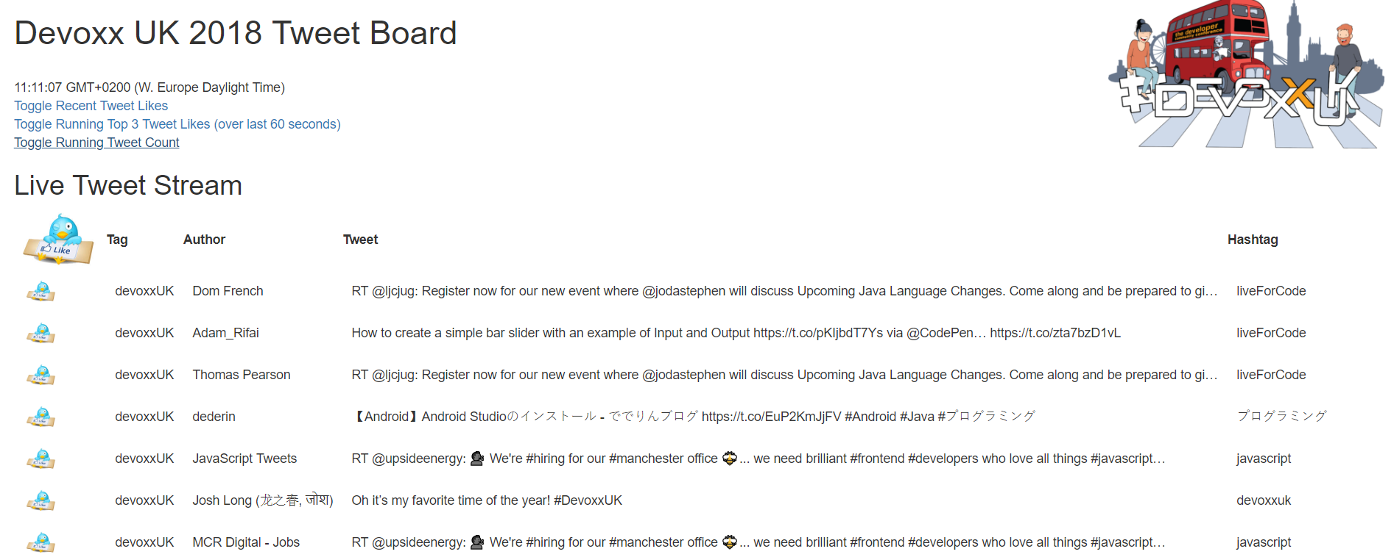
Following along (and help with) the Demo
http://bit.ly/ActiveUIDevoxxUK

Slide 13
Events
Consumers
Producers
Robust, Scalable, History Retention
Containerized/Cloud-enabled

Slide 14
Requirements for Event capability
Provide decoupling between publisher and consumer
In time/availability, technology, load processing capacity, location, ownership & responsibility
Generally accessible for all consumers
Using standardized protocols and formats for communications and event payload (http, JSON)
Scalable (handle high loads)
Available (allow speedy event publication)
Reliable (do not lose events, at least once delivery, exactly once delivery)
Event Ordering (provide events in the order of publication)
Retain Event History
For consumers that are late to the game – or not available all the time
To construct state from all historic events: Event Sourcing
To perform streaming analysis over long running time windows

Slide 15


Introducing Apache Kafka
..- 2010 – creation at Linkedin
Message Bus | Event Broker | Streaming Data Platform
High volume, low latency, highly reliable, cross technology Commit Log (ledger)
Scalable (#messages & #consumers), distributed, durable, strict message ordering, ….
2011/2012 – open source under the Apache Incubator/ Top Project
Backed by Confluent – Confluent Open Source & Confluent Enterprise
Kafka is used by most many [large] corporations:
And embraced by [almost] all many software vendors & cloud providers
Client libraries available for NodeJS, Java, C/C++, Python, Ruby, PHP, Scala, Clojure, Rust, .NET, go (aka golang) and many more
Apache Kafka includes Connect, Mirror Maker, Streams
KSQL is Open Source, part of the Confluent Platform
Notes:
https://cwiki.apache.org/confluence/display/KAFKA/Clients

Slide 16
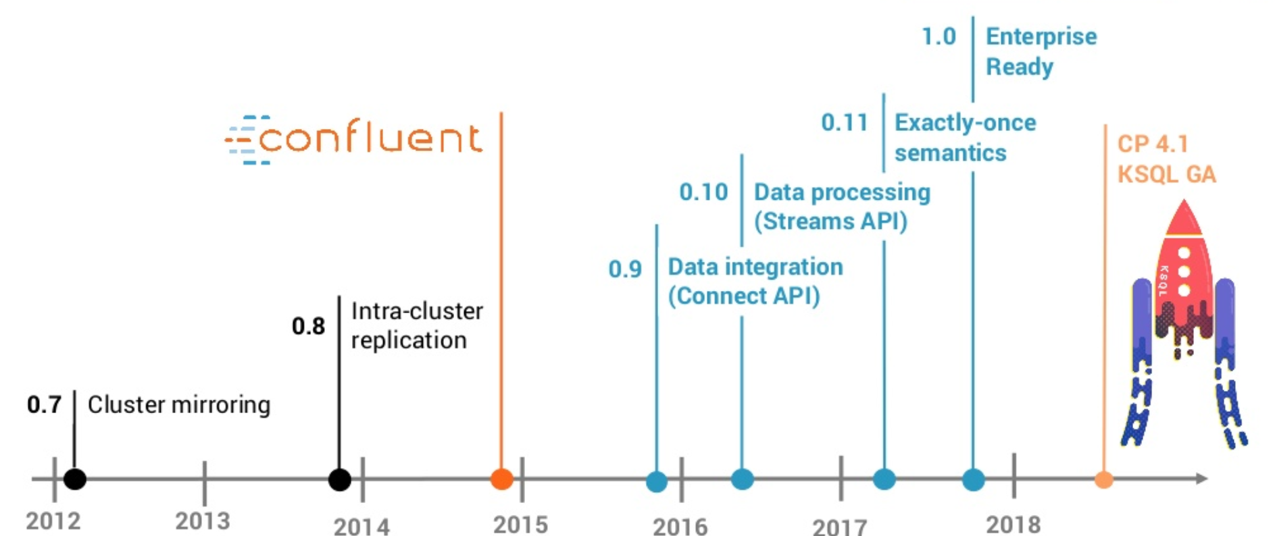


Slide 17
Kafka terminology
Message
Topic
partition
Message
== ByteArray
Broker
replicated
Producer
Consumer
Working together in Consumer Groups
Key
Value
Time
Producer
Consumer
Broker
Topic

Slide 18



Consumers
tcp
Producers
tcp
Broker
Topic

Slide 19

The case at hand – step one
Tweets on #devoxxUK #java #oraclecode
Tweets
Topic
Show live tweet feed for each tag in each client
Client
Client
Client
Client

Slide 20


The case at hand – step one and a half
Tweets on #devoxxUK #java #oraclecode
Tweets
Topic
Show live tweet feed for each tag in each client
Client
Client
Client
Client

Slide 21



The case at hand – step one and two
Oracle Cloud
Tweets on #devoxxUK #java #oraclecode
Application Container
Event Hub
Tweets
Topic
Show live tweet feed for each tag
Client
Client
Client
Client

Slide 22
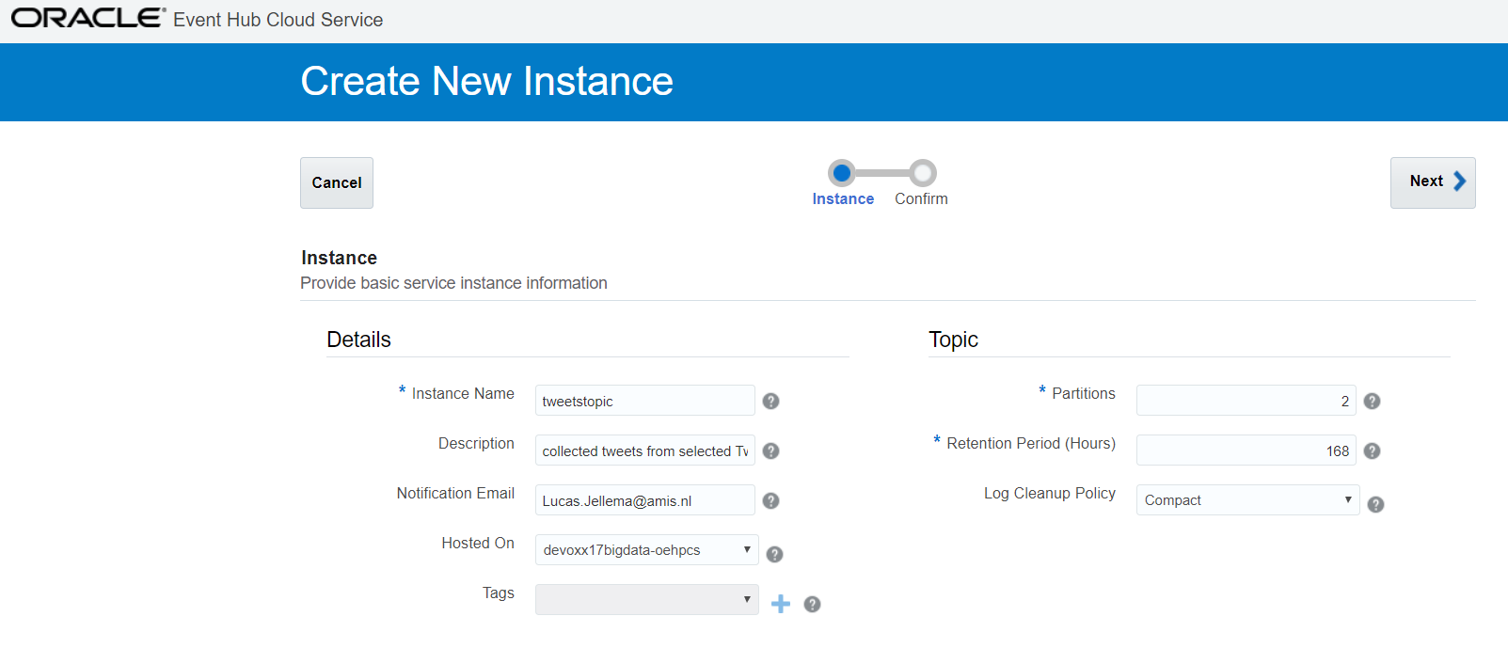
Event Hub
Tweets
Topic

Slide 23
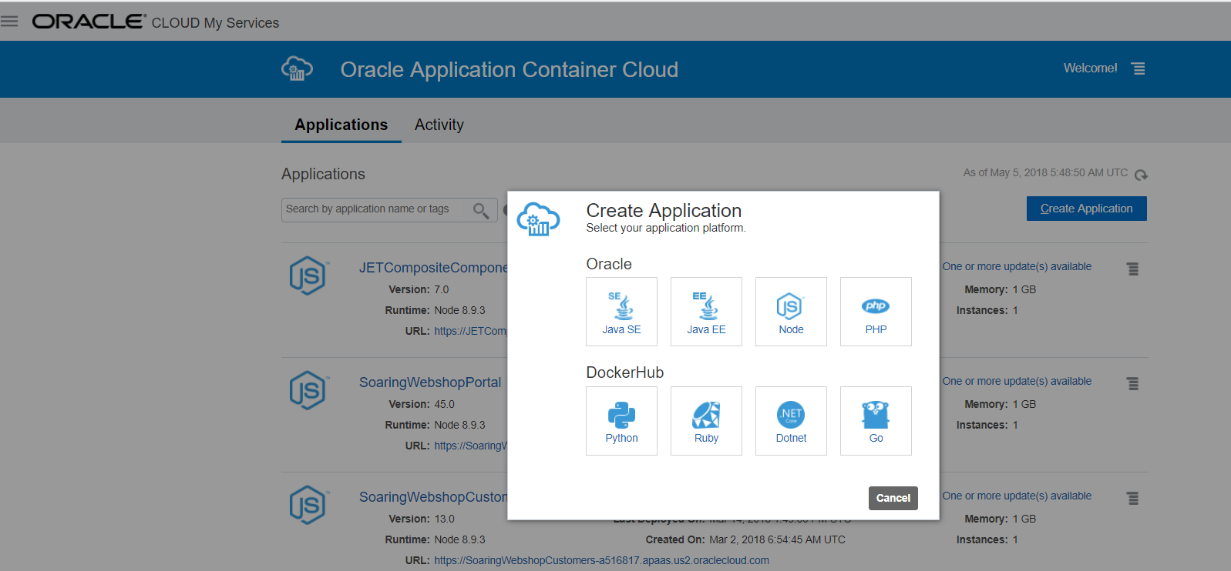
Application Container

Slide 24
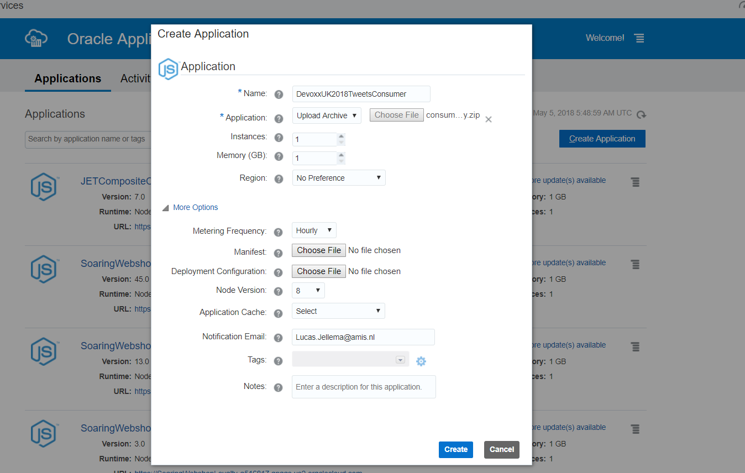
Application Container

Slide 25
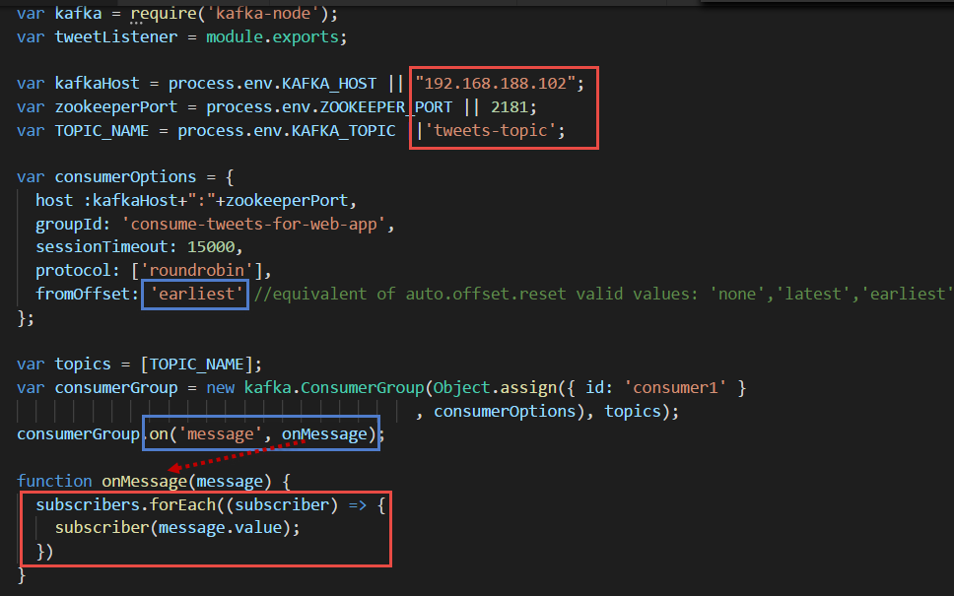
Kafka consumer in node gets events pushed into application

Slide 26
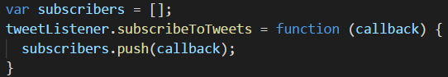
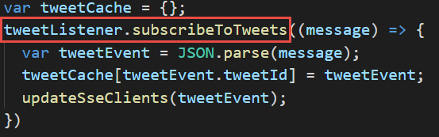
Web App registers listener with Kafka Event Consumer

Slide 27
The case at hand Server sent events for push back
Tweets on #devoxxUK #java #oraclecode
Tweets
Topic
Show live tweet feed for each tag
Client
Client
Server Sent Event
Client
Client

Slide 28
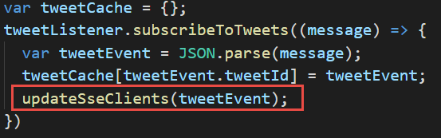
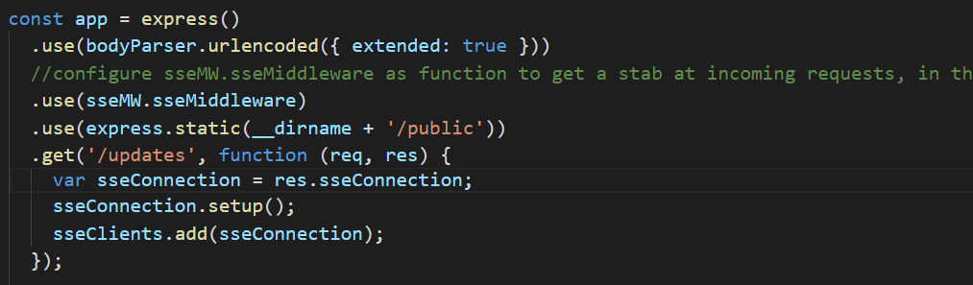
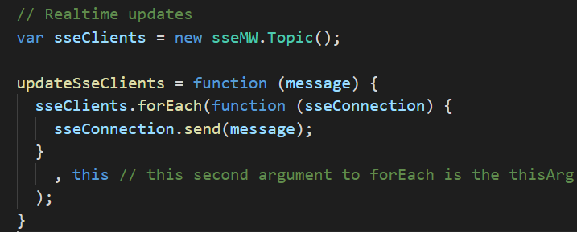
Server sent event – server side

Slide 29
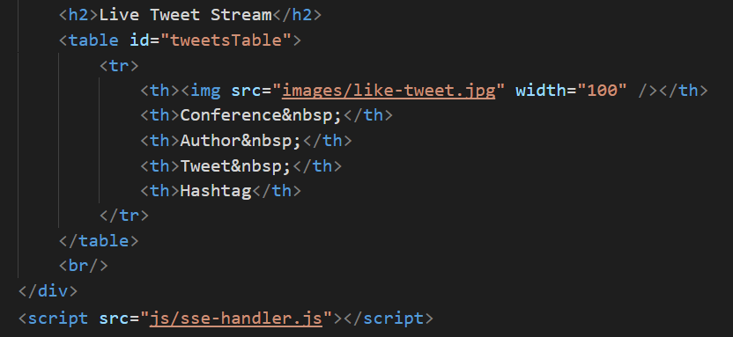
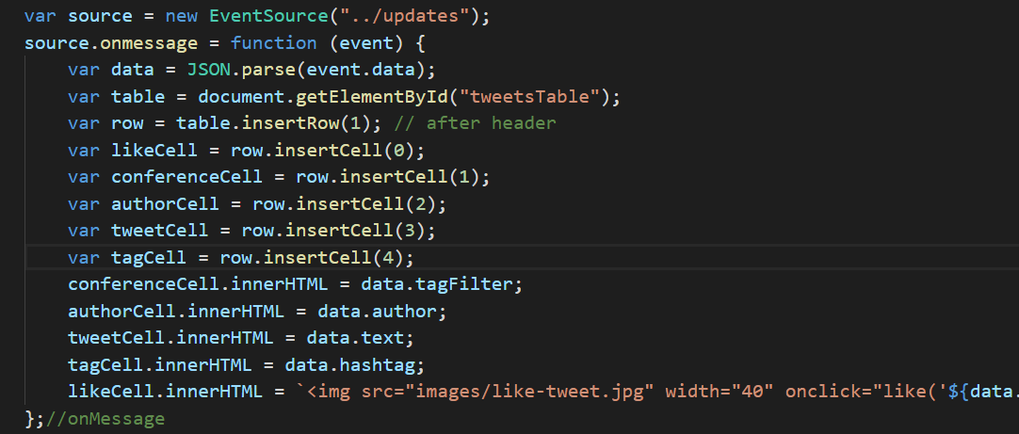
Server sent event – Client side

Slide 30
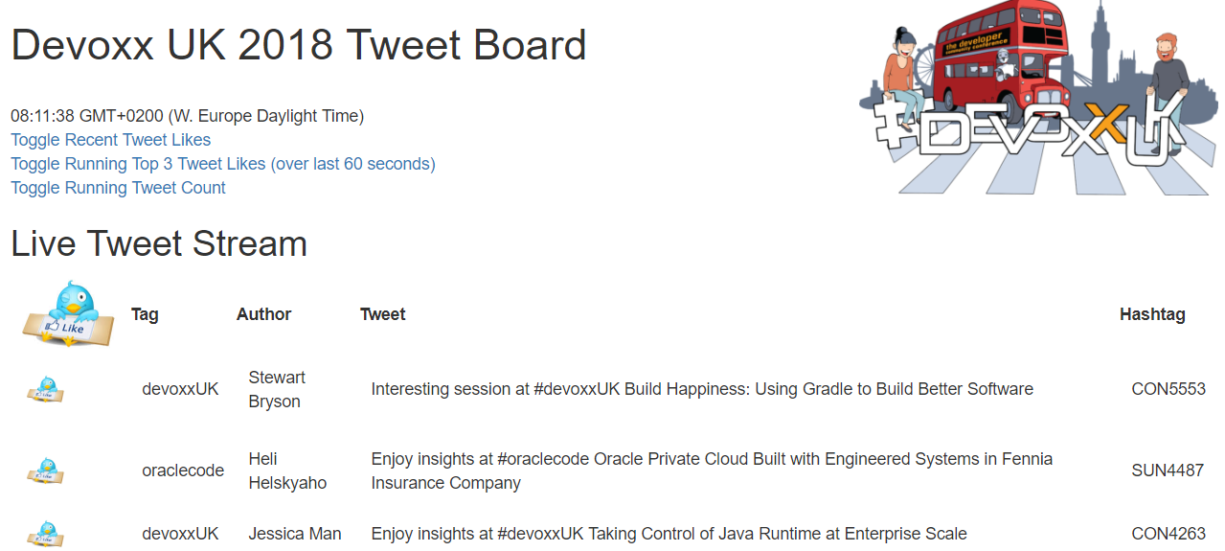
Live tweet stream
Server Sent Event

Slide 31

The case at hand Tweet Likes – client to server to all clients
Tweets on #devoxxUK #java #oraclecode
Tweets
Topic
Show live tweet feed for each tag
Allow users to like tweets –and show live list of liked tweets
Client
Client
SSE
Client
Client

Slide 32
The case at hand Web sockets – for bi directional push
Tweets on #devoxxUK #java #oraclecode
Tweets
Topic
Show live tweet feed for each tag
Allow users to like tweets –and show live list of liked tweets
Client
Client
WebSockets
SSE
Client
Client

Slide 33
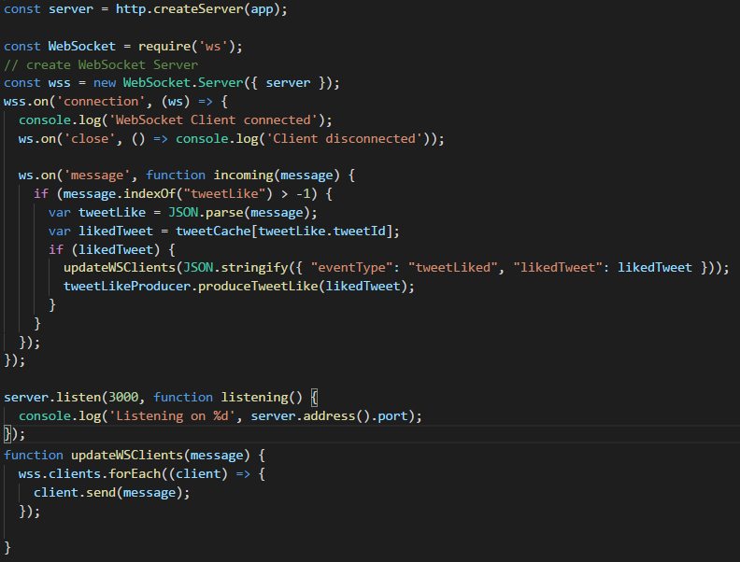
Websockets – server side

Slide 34
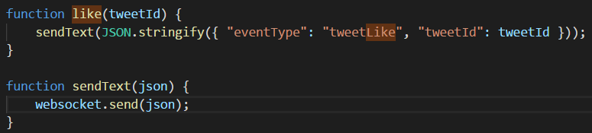
Websockets – Client side - publishing
Client
WebSockets

Slide 35
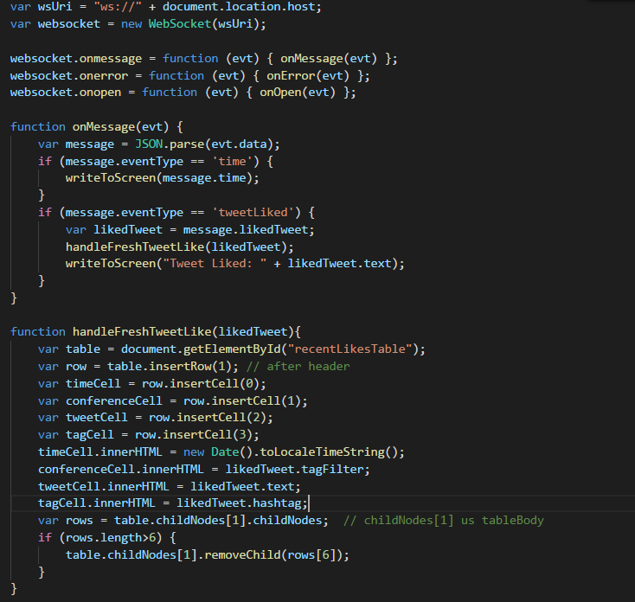
Websockets – Client side - Consuming
Client
WebSockets

Slide 36

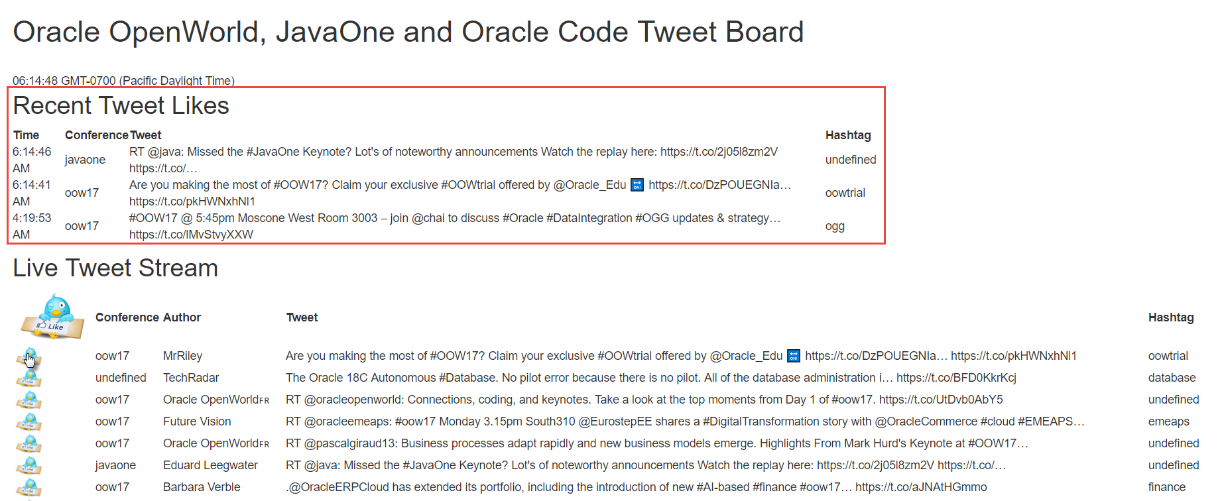
Tweet likes broadcasting
WebSockets
WebSockets

Slide 37
The case at hand: Running Count Streaming analysis of tweet events
Tweets on #devoxxUK #java #oraclecode
Show live tweet feed for each tag
Tweets
Topic
Allow users to like tweets –and show live list of liked tweets
Show live tweet aggregates per tag
Client
Client
WebSockets
SSE
Client
Client

Slide 38

The case at hand - Streaming analysis of Tweets
Tweets on #devoxxUK #java #oraclecode
Show live tweet feed for each tag
Tweets
Topic
tweetAnalytics Topic
Allow users to like tweets –and show live list of liked tweets
Show live tweet aggregates per tag
Streaming Tweets Aggregation
Client
µ
Client
WebSockets
SSE
Client
Client

Slide 39
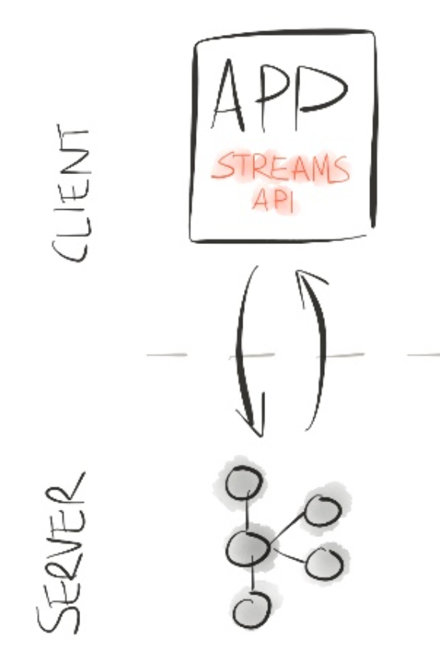

Kafka streams
Real Time Event [Stream] Processing integrated into Kafka
Aggregations & Top-N
Time Windows
Continuous Queries
Latest State (event sourcing)
Turn Stream (of changes) into Table (of most recent or current state)
Part of the state can be quite old
Exactly-once processing in Kafka Streams (as of 0.11.0)
Note: Kafka Streams is relatively new
Only support for Java clients; Scala client is planned too

Slide 40
Kafka streams
Topic
Filter
Aggregate
Topic
Join
Map (Xform)
Topic
Publish

Slide 41
Example of Kafka streams
Topic
Set Conference as key
groupBy
Sum/Avg/Top3 by key (==tagFilter)
TweetMessage
Tag
Text
Author
Aggregate
and possibly per time window
Topic
Join
e.g. Author Details
Round aggregate to nearest 100
Map (Xform)
As JSON
Publish
Topic: CountTweetsPerTag

Slide 42
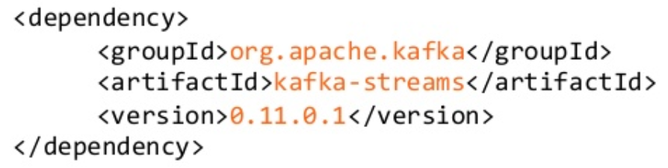
Add Kafka Streams capabilities to any Java application
Add Maven Dependency
Connect to Kafka Cluster
Compose & Execute Kafka Streams logic:
Write Java code

Slide 43
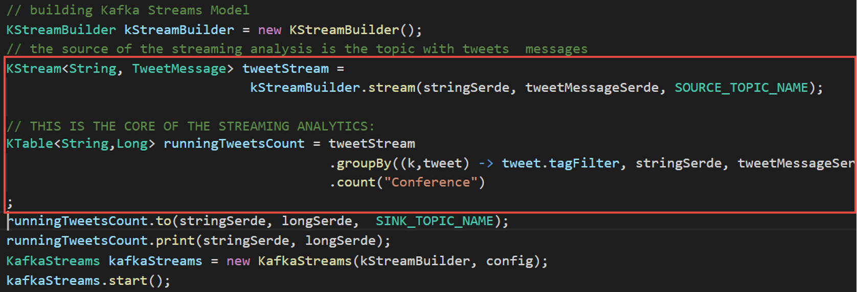
Kafka streams – running count tweets per conference

Slide 44

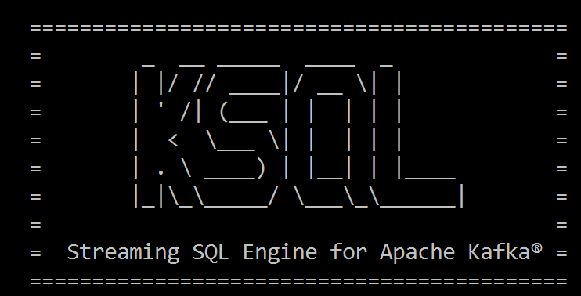
Wouldn’t it be nice if you could just do
select tagfilter
, count(*) as tag_cnt
from tweets
window hopping ( size 5 minutes , advance by 30 seconds)
group by tagfilter

Slide 45
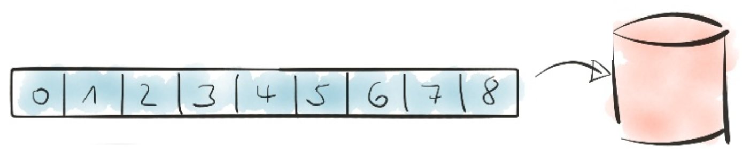
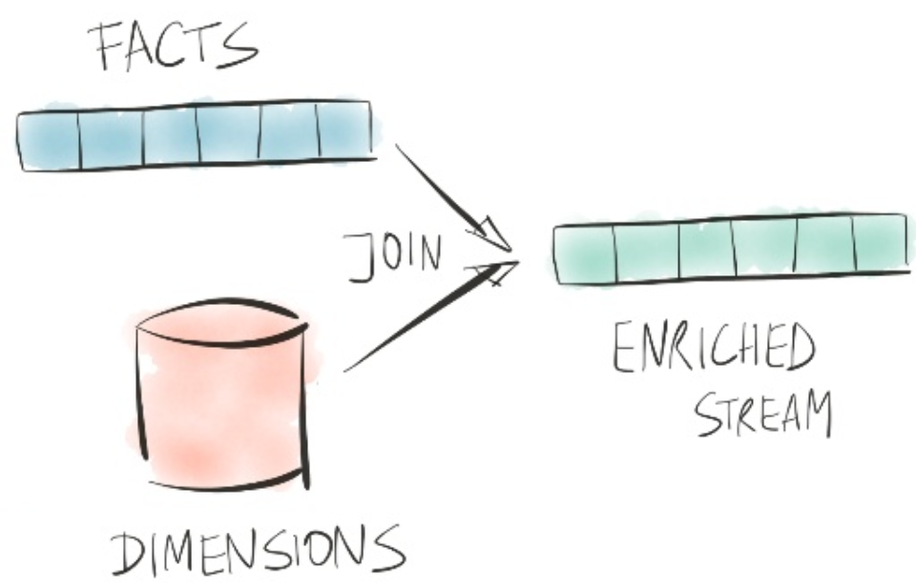

KSQL – Continuous Queries – processing event streams like tables
Transform, Filter, Join, Aggregate, (time) Window on Event Streams
Results are produced as regular Kafka Events

Slide 46
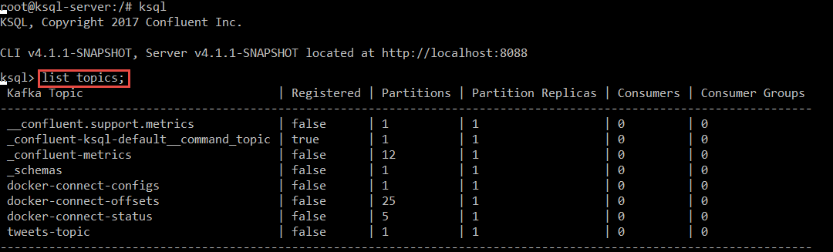
Running tweet Count Through KSQL

Slide 47
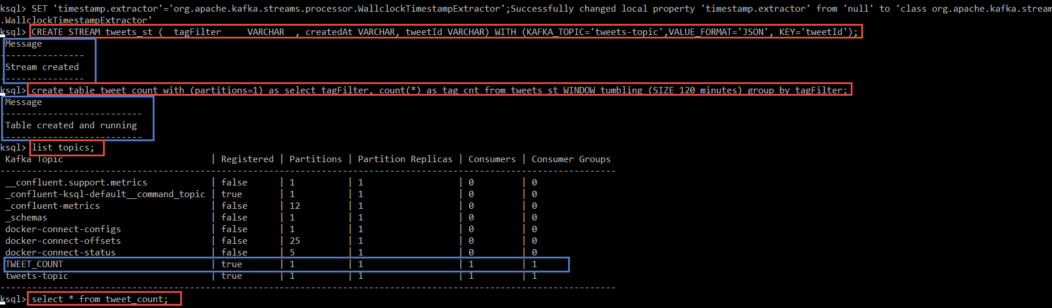
Running tweet Count Through KSQL
KSQL CLI
List topics
Print topic
Create stream
Create table
List Topics
Query from table

Slide 48
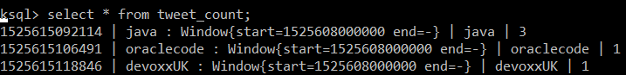
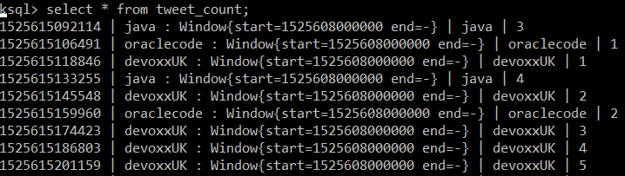
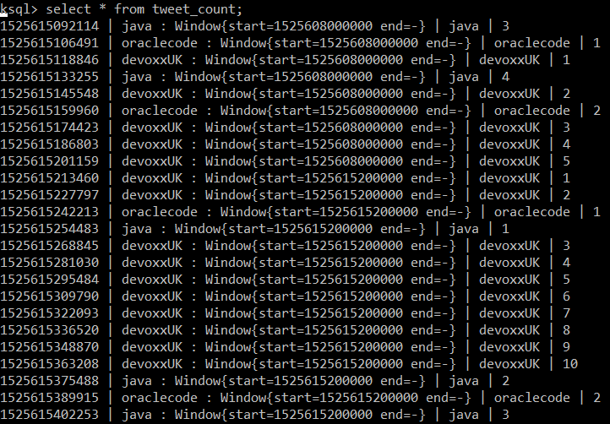
Running tweet Count Through KSQL

Slide 49

KSQL Running count of tweets per tag results published on kafka topic
Running Tweets Aggregation
Tweets on #devoxxUK #java #oraclecode
Show live tweet feed for each tag
Allow users to like tweets –and show live list of liked tweets
Tweets
Topic
TWEET_COUNT Topic
Show live tweet aggregates per conference
Show a live list of top 3 liked tweets per tag
Client
Client
SSE
Client
Client

Slide 50
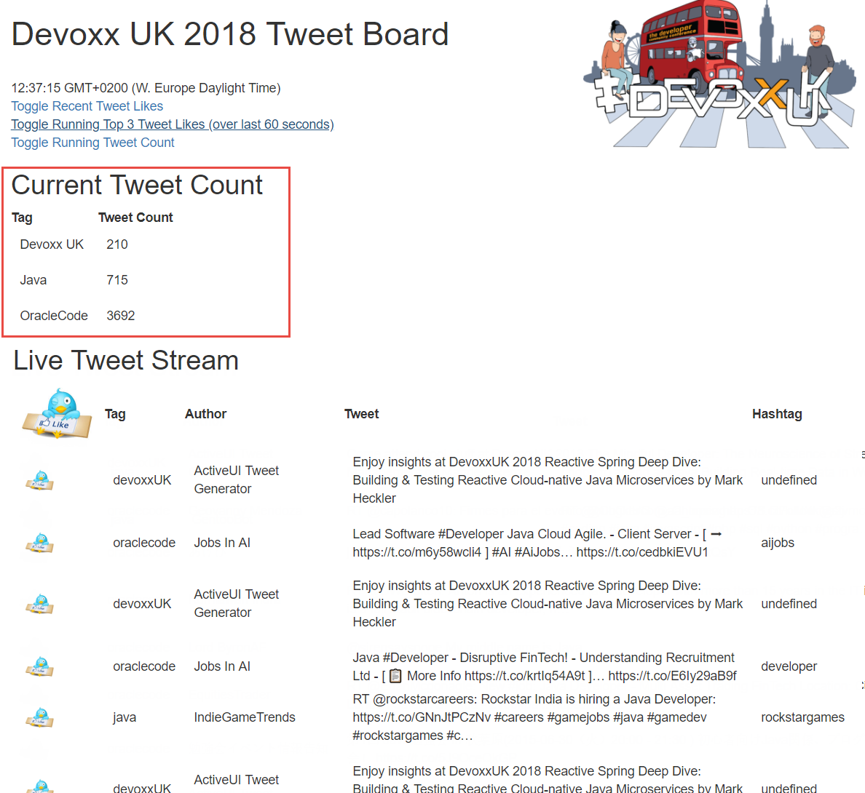
Streaming tweet analytics - pushed to client
Server Sent Event

Slide 51

KSQL interfaces
Java Application
HTTP REST API
CLI
JDBC Driver
KSQL Server
Kafka Streams API
Kafka Cluster
Topic
KStream
KTable
Topic
Topic
KTable
KStream
Topic
Topic

Slide 52
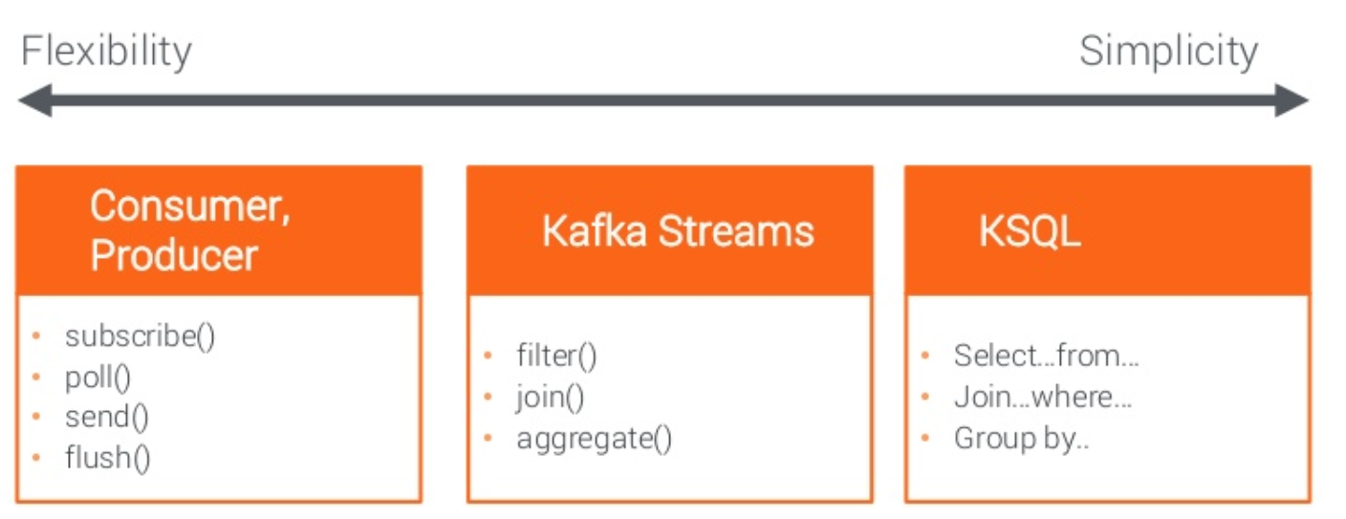
The three flavors of Stream[ing] analytics With Kafka
Kafka Cluster
Topic
KStream
KTable
Topic
Topic
KTable
KStream
Topic
Topic

Slide 53
The case at hand – Streaming analysis of Tweet likes
Running Tweets Aggregation
Tweets on #devoxxUK #java #oraclecode
Show live tweet feed for each tag
Allow users to like tweets –and show live list of liked tweets
Tweets
Topic
TWEET_COUNT Topic
Show live tweet aggregates per conference
Show a live list of top 3 liked tweets per tag
Client
Client
WebSockets
SSE
Client
Client

Slide 54
The case at hand - Streaming analysis of Tweet likes
Running Tweets Aggregation
Running Top3 Like Counts Aggregation
Tweets on #devoxxUK #java #oraclecode
Tweet_Like_Counts
Topic
Show a live list of top 3 liked tweets per tag
Tweets
Topic
TWEET_COUNT Topic
Tweet-Like
Topic
Client
Client
WebSockets
SSE
Client
Client

Slide 55
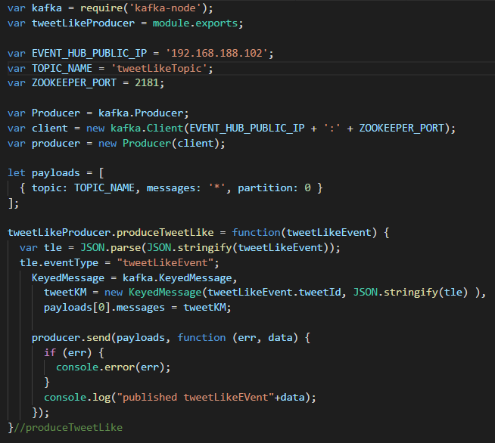
Websockets – server side Produce Tweet Like events

Slide 56
Create stream from topic & Table from stream
create stream tweet_likes ( tweetid varchar) with (kafka_topic='tweet-like_topic' , value_format='json', key='tweetid'); create table like_counts as select count(*) likecount
, tweetid
, tagfilter from tweet_likes window hopping ( size 60 seconds , advance 10 seconds) group by tweetid, tagfilter;

Slide 57
Create stream from table & enriched stream from stream
create stream top3_likes as select tweetid, tagfilter, topk( likecount, 3) from like_counts group by tagfilter;
create stream enriched_top3_likes as select tl.tagfilter, tl.tweetid, t.text, t.rowtime from top3_likes tl left join tweets t on tl.tweetid = t.tweetid;

Slide 58
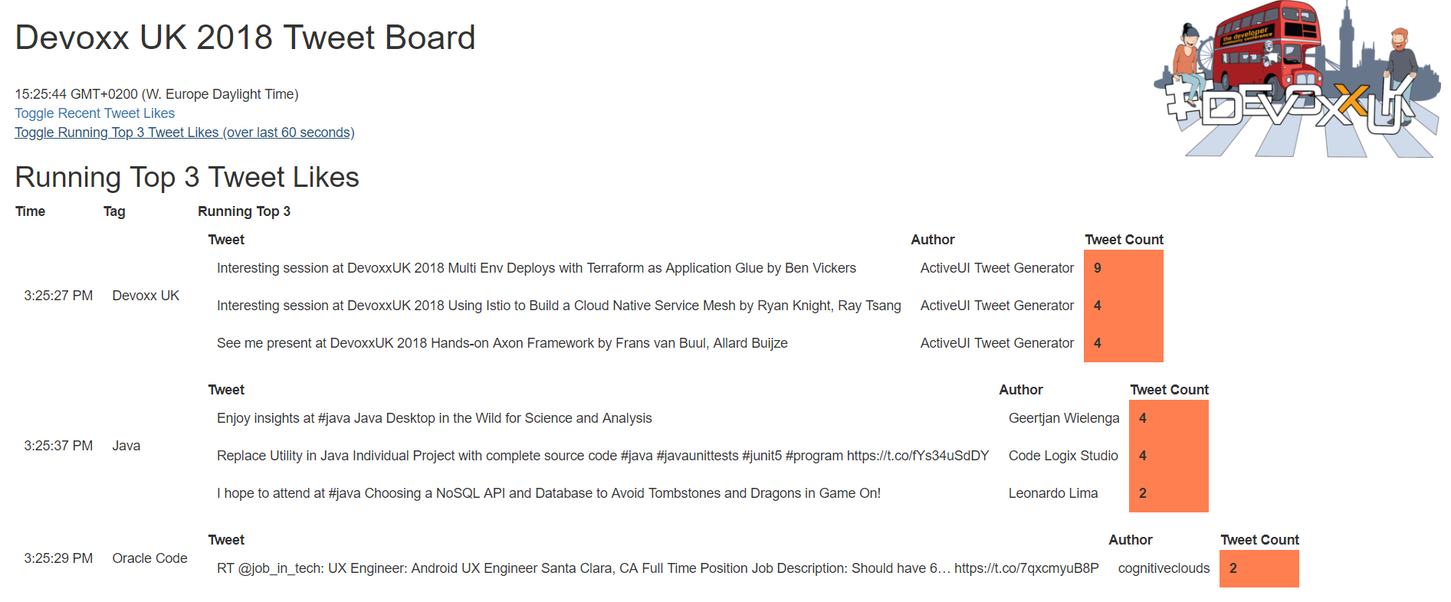
Running Top 3 of best liked tweets per conference
Server Sent Event

Slide 59

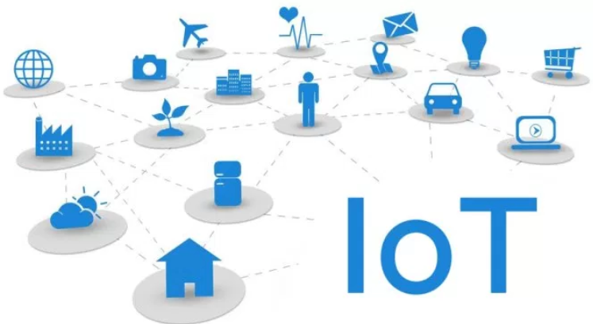

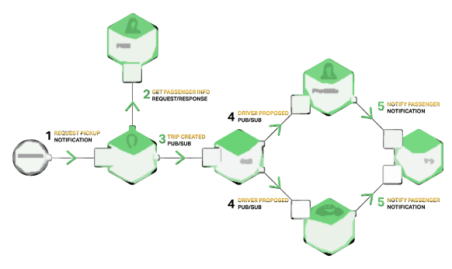




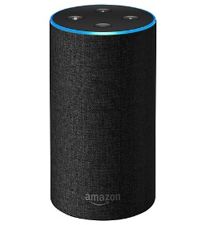


Oracle Cloud
Tweets on #devoxxUK #java #oraclecode
IoT metrics from hundreds of devices
User actions & click events from webshop
Live Traffic Events
Microservices chatter
Social Media events (Facebook, Whatsapp, …)
IT Operations – monitoring metrics
Application Container
Event Hub
Tweets
Topic
Client
Client
Client
Client
Web
Sockets
Running Tweets Aggregation
Running Top3 Like Counts Aggregation
SSE
Tweet_Like_Counts
Topic
µ
µ
Tweets
Topic
TWEET_COUNT Topic
Tweet-Like
Topic
µ
µ

Slide 60


Conclusion
Fast data – Active UI & Active API leveraging live data streams
Proactively informing consumers with [results from streaming analysis of] events
Decoupled processing
Unentangled, separated in space and time
Distributed across clouds and on premises
Kafka
Scalable, reliable, historic Events & Data Store
Streaming Analysis –Kafka Streams and KSQL
Modern browser – push capability & bi-directional communication
SSE, WebSocket, HTTP/2, WebWorker Notifications
Active UI with happy users, fresh data without burden on back end systems
“Step away from that F5 key”

Slide 61



https://github.com/lucasjellema/devoxxUK18-active-ui-streaming-analysis
Blog: technology.amis.nl
Email: lucas.jellema@amis.nl
: lucasjellema
: lucas-jellema
: www.amis.nl, info@amis.nl +31 306016000 Edisonbaan 15, Nieuwegein

